Slide 1
Tucannon River Programmatic Habitat Program
(a 30 mile long project)
Steve Martin, Director, Snake River Salmon Recovery Board
Kris Buelow, Tucannon Programmatic Project Manager
Kris Fischer, Confederated Tribes of the Umatilla Indian Reservation
Heidi McRoberts, Nez Perce Tribe
Dave Karl, Washington Department of Fish and Wildlife
Umbrella Project Review
2.16.2017
#2010-077-0

Slide 2
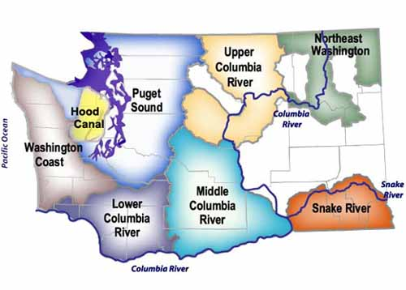
Snake River Salmon Recovery Board
Notes:
The project is managed by the SRSRB
SRSRB is (1 of 7) Regional Salmon Recovery board helping to convene and manage salmon recovery throughout the lower Snake and Walla Walla
describe the SRSRB and their role in public involvement and project buy in as well as final funding approval.
Convenes local RTT and participates on a broad spectrum of recovery related activities

Slide 3

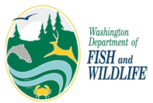
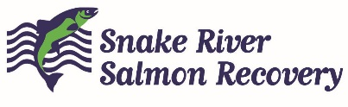

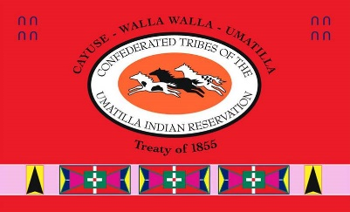



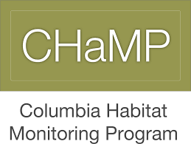
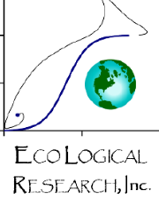
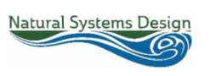
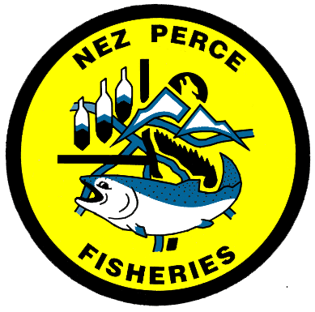
Tucannon Programmatic Partnership
Tucannon Landowners

Slide 4
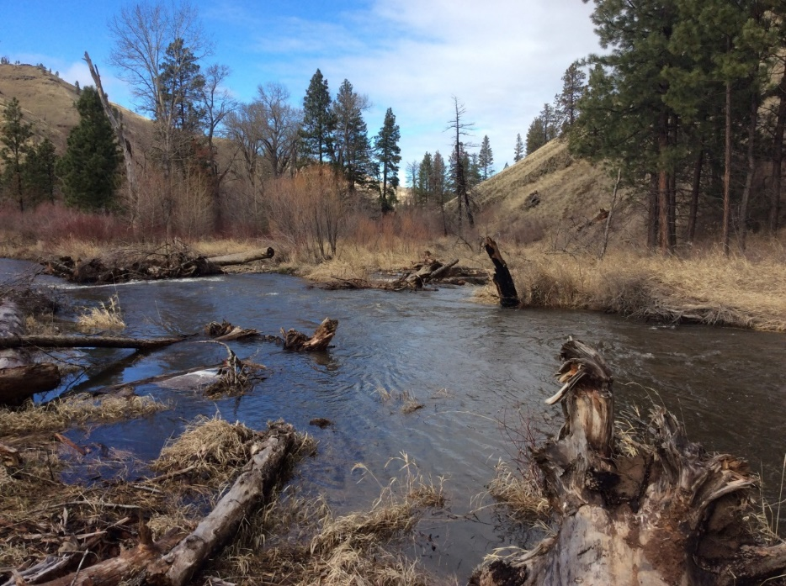
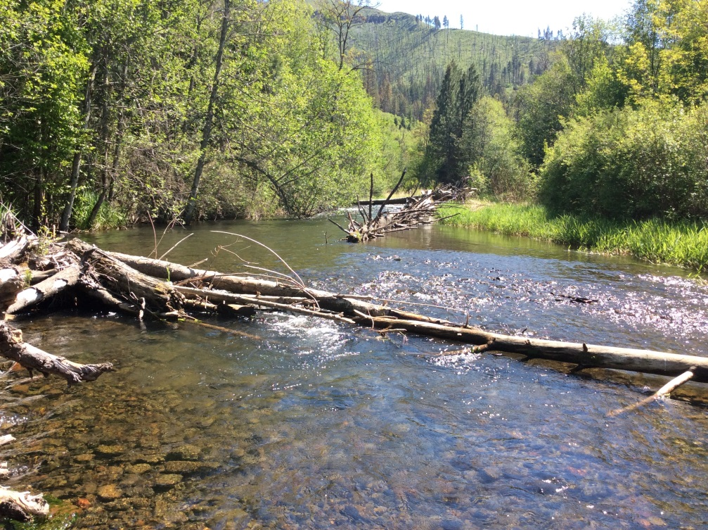
Outline
Programmatic Process
Objectives
Accomplishments
Effectiveness Monitoring

Slide 5
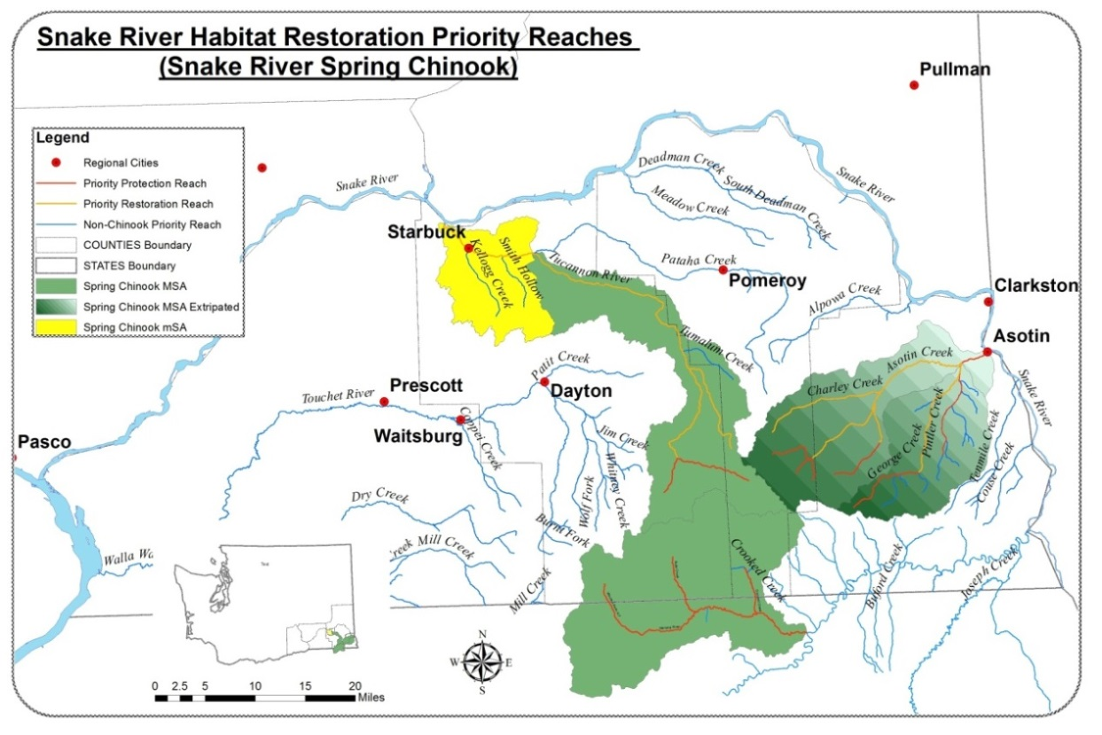
Tucannon Watershed
Notes:
Located SE WA in the Blue Mts.
Main Channel 58 miles in length
Summer Steelhead, fall chinook bull trout and spring chinook
Nearest populations are the Clearwater, Asotin and Grande Ronde

Slide 6
Spring Chinook Total Return
4,311
Notes:
Low Chinook population is the reason for the programmatic in the Tucannon
Spring Chinook were listed in 1992
Recovery Goal of 750 with at a ten year geometric mean
Restoration goal is of 2,400-3,400

Slide 7

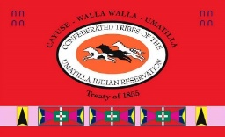
Tucannon River Partnership
Tucannon Implementation Partners
Snake River Salmon Recovery Board (SRSRB)
Columbia Conservation District (CCD)
Washington Department of Fish and Wildlife (WDFW)
Confederated Tribes of the Umatilla Indian Reservation (CTUIR)
_{Nez Perce Tribe (NPT)}
_{Landowners}

Slide 8
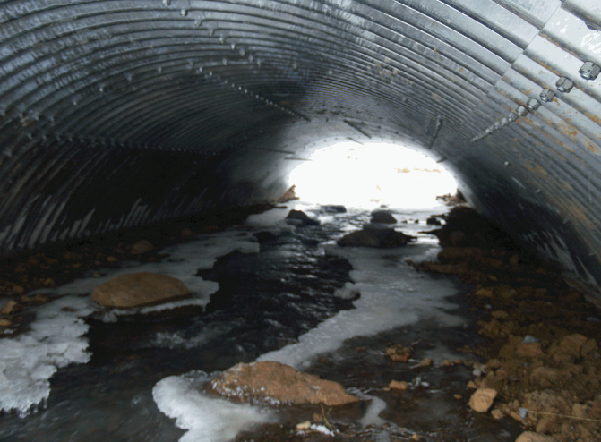
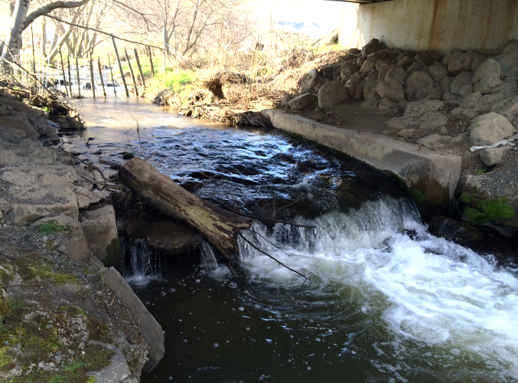
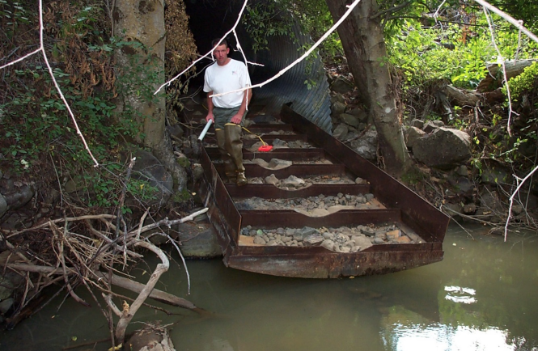
Nez Perce Tribe Accomplishments
Fish Passage Projects– Funded by PCSRF
Pataha Creek Culvert Replacements
    Two fish passage culvert replacements/log weirs removed
    2014 Implementation
Alpowa Creek Fish Passage
    Fish Passage Barrier Improvement Project
    2017 Implementation
Buford Creek Fish Passage
    Fish Passage Barrier Improvement Project
    2016/17 Design & 2018 Implementation

Slide 9
Set watershed restoration goals
Tucannon Process
Assess & inventory watershed conditions
Salmon Recovery Plan for SE WA
Sub basin Plan
Identify problems & potential actions
Geomorphic Assessment
(Anchor QEA)
Conceptual Restoration Plan
(Anchor QEA)
Review & select appropriate restoration techniques
Tucannon Coordination Committee
SRSRB Regional Technical Team
Prioritize restoration actions
Tucannon Implementers Committee
Adaptive management
Design restoration project & monitoring
Rapid Habitat Surveys
CHaMP, AEM, Fish-in /Fish-out
Fig 1 Major steps in the restoration process to develop a comprehensive restoration program and well-designed restoration project. (Roni and Beechie, 2013)
Implement restoration & monitoring
Publish results & modify goals & management
Modify Goals and Objectives

Slide 10
Limiting Factors – Restoration Objectives
_{Tucannon Limiting Factors}
2004 Sub Basin Plan (NW Power Council)
2005/2011 Salmon Recovery Plan (SRSRB)
Tucannon Geomorphic Assessment (Anchor QEA, 2011)
Conceptual Restoration Plan (Anchor QEA 2011)
_{Restoration Ecological Process}
_{Geomorphic Change}
_{Natural Function}

Slide 11
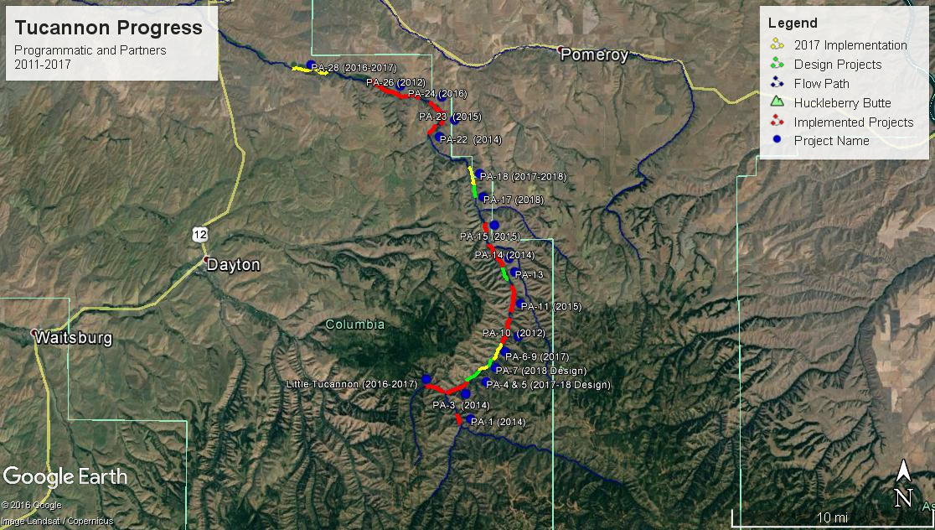
30 Mile Reach
Notes:
Points:
The upper 30 miles = the priorities identified in the Assessment and conceptual plan.
Ten projects completed to date and 3 (5) more planned for 2017.
Three additional projects in design phases for implementation in 2018-20.
We are starting to knit the project sites together especially in the upper 20 miles.

Slide 12
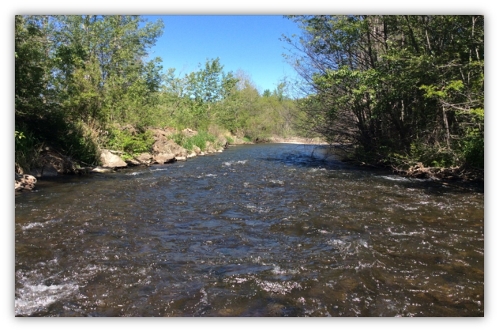
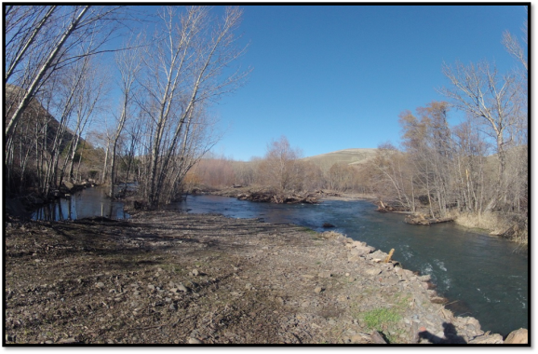
Floodplain Connectivity (Levees)
Flow
Notes:
Example of a project reach with a floodplain connectivity objective
11,428’ of River Levee and confining structure removed ~164 acres of floodplain connected
These are right now connectivity but still may require LWD and channel modifications before full benefits are realized “time”………..

Slide 13
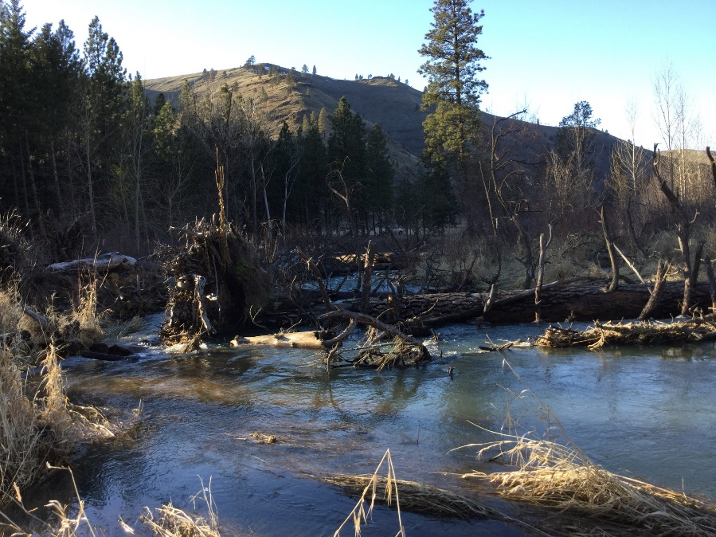
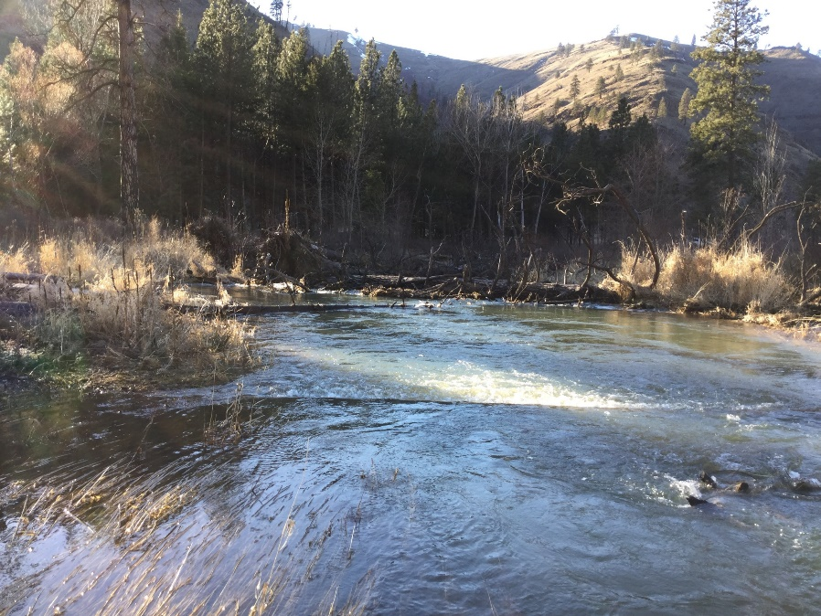
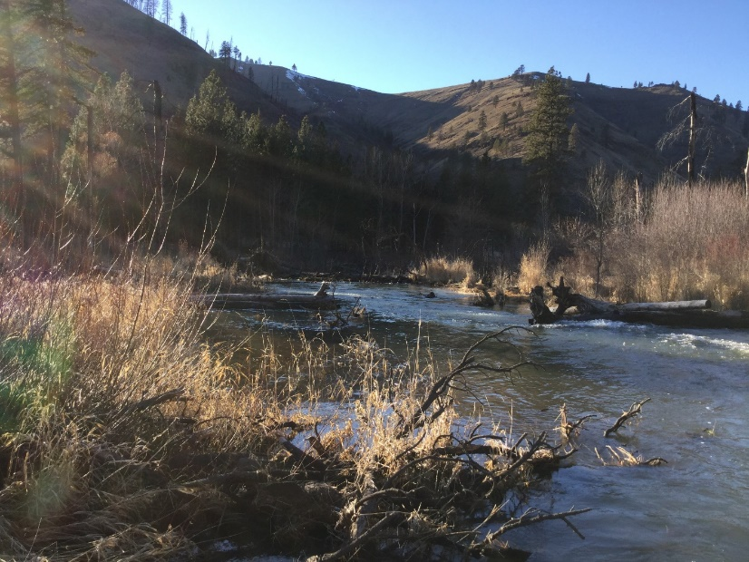
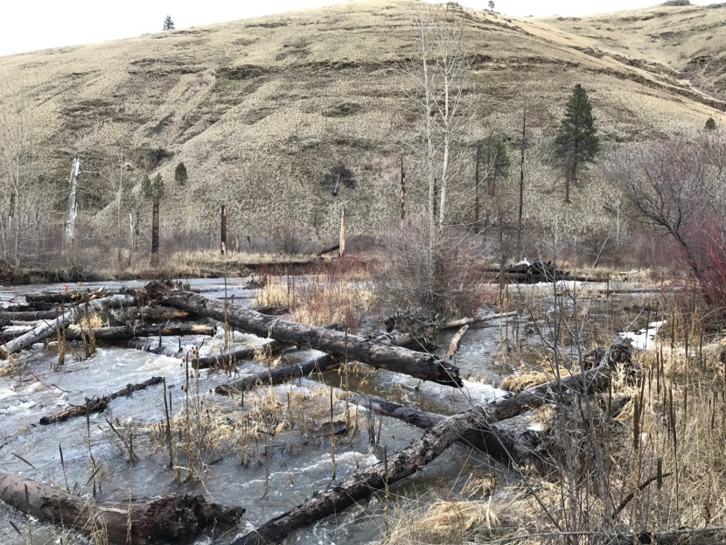
Floodplain Connectivity (LWD)
> 10 miles built
Notes:
LWD structures have been placed to increase flood frequency and connectivity.
> 10 miles have been treated with wood at an intensity which will improve connectivity over time
Some will occur quickly and others will take time for geomorphic change to occur based on flow and sediment movement.
During a bigger flow event it is expected have large gains in connectivity

Slide 14
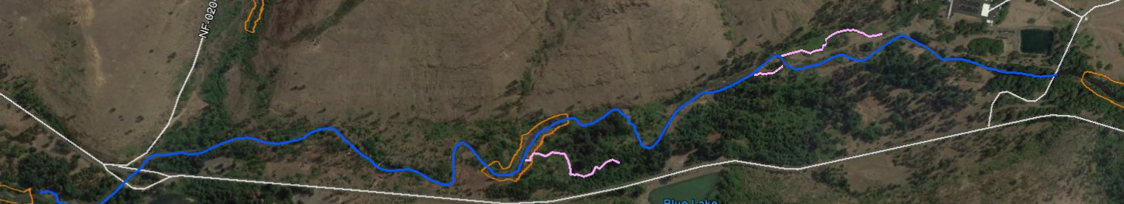
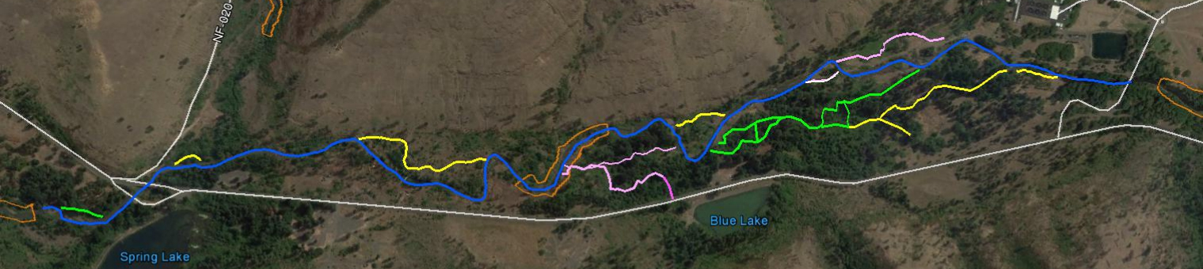
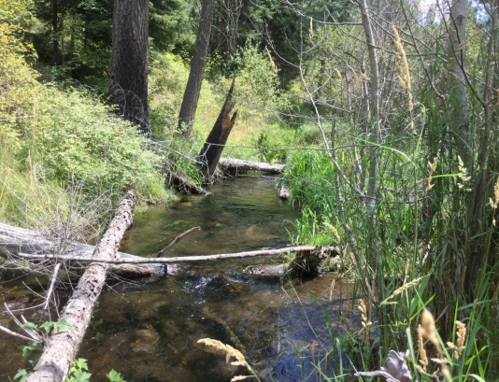
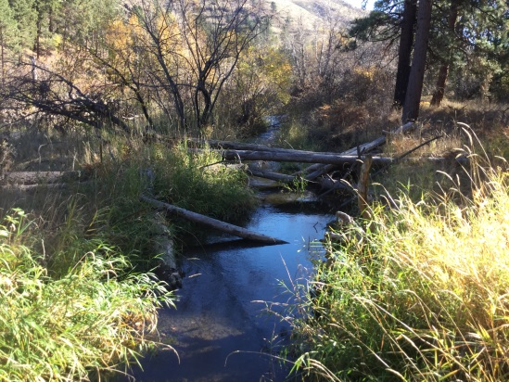
Side Channels (Connectivity)
> 4 miles reconnected
Flow
Notes:
Project have reconnected side channels for the purpose of connecting floodplains and providing off channel habitats
4.15 miles side channels reconnected/created 3.59 mile 2017

Slide 15
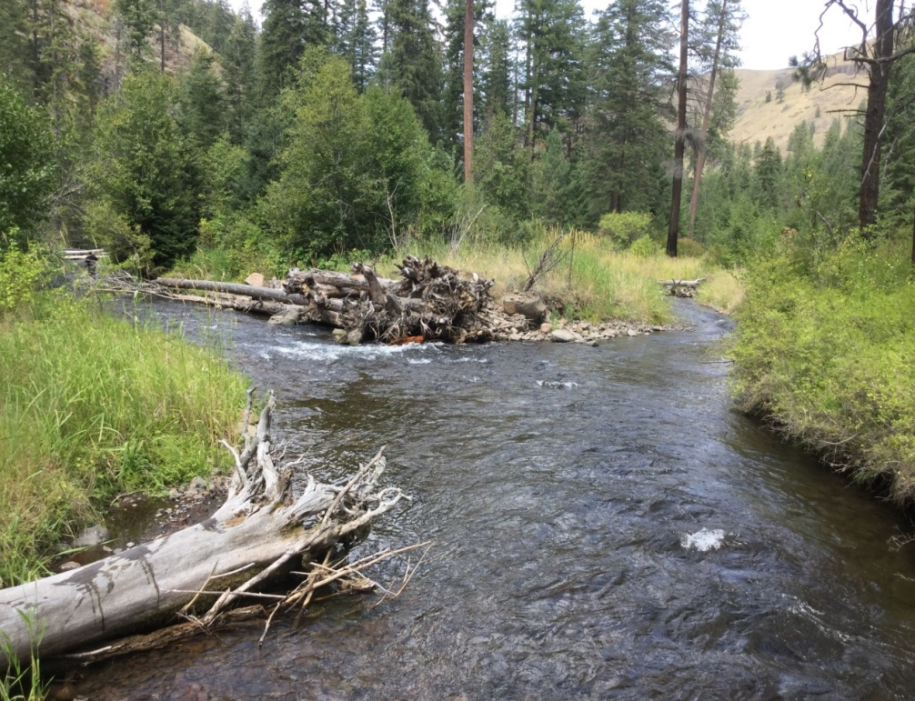
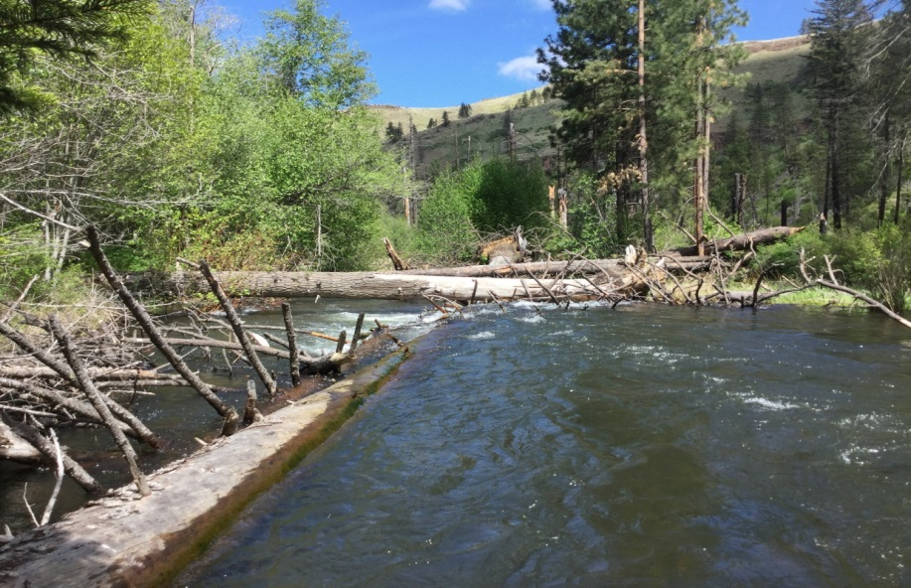
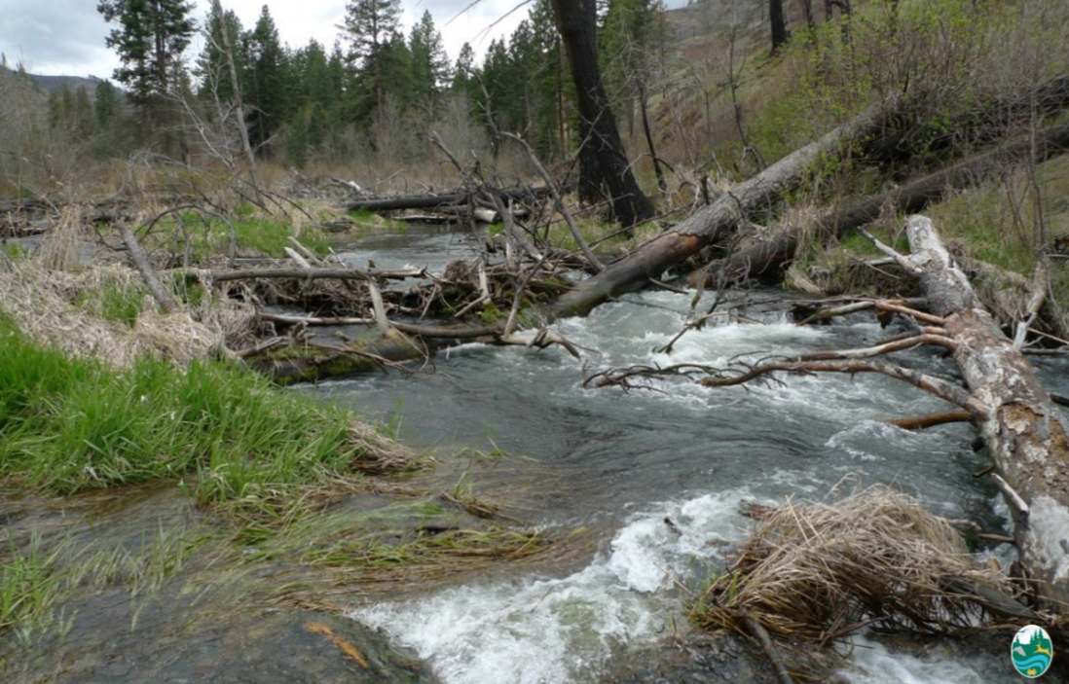
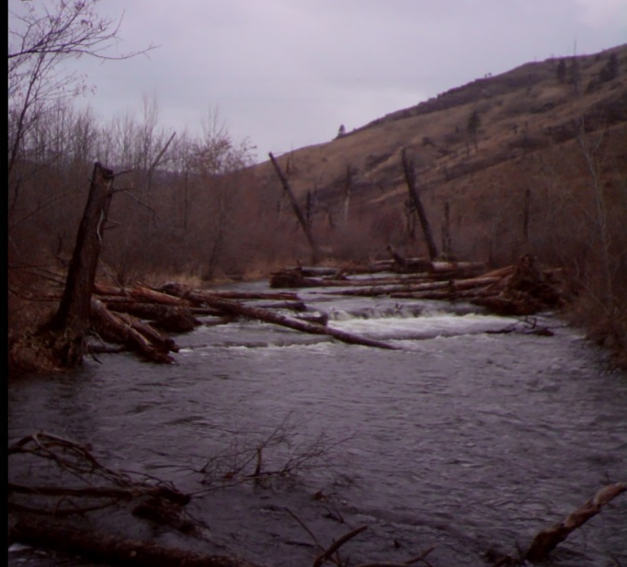
Channel Complexity
>12 miles treated, with 450 structures and >3,500 key pieces
Notes:
River miles treated with 12.5 miles by 2016 and another 4.5 miles in 2017. Structure placed 450 plus 170 more in 2017. 3540 key pieces and ~ 1000 more in 2017

Slide 16
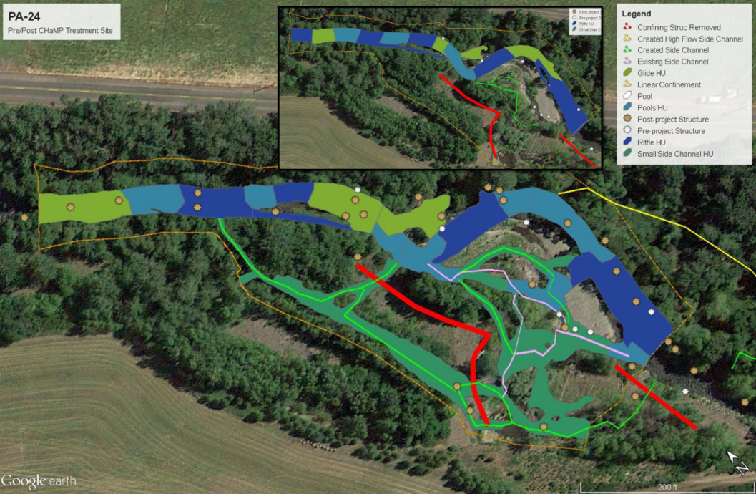
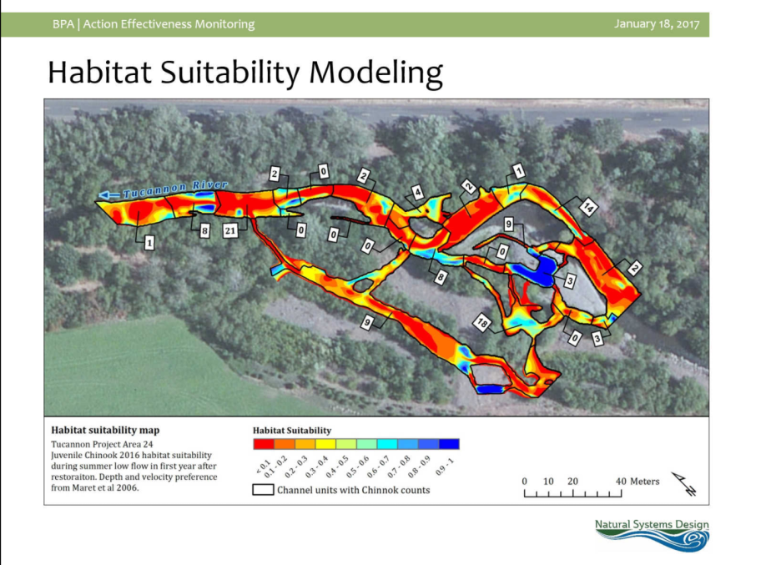
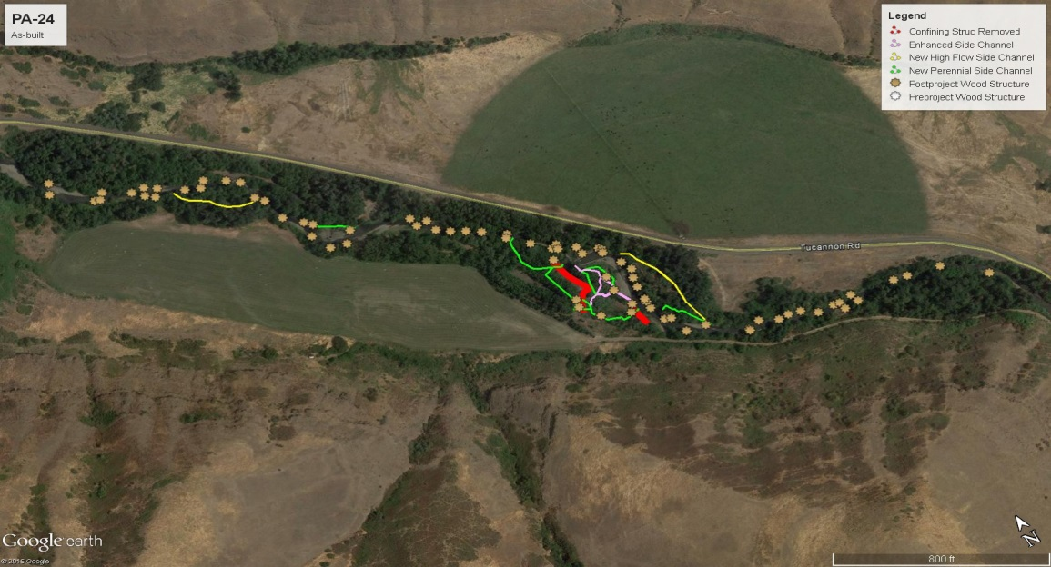
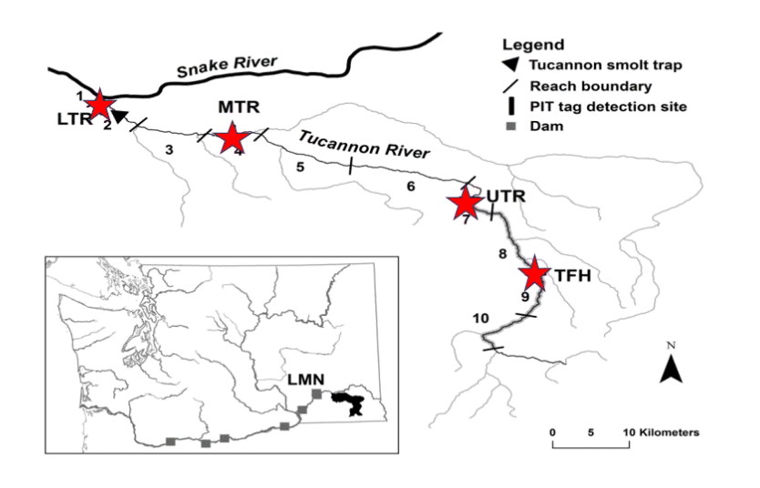
Habitat Monitoring
CHaMP Habitat Units Change Detection
AEM –Fish Use Snorkel Data
Rapid Habitat Survey “As-built”
WDFW Fish in Fish Out and Habitat Use
Notes:
Monitoring within the basin has been a coordinated effort between CHaMP, AEM, WDFW and the SRSRB in the collection of physical and biological data within a robust study design targeting control treatment sites coordinated with the implementation of restoration projects.

Slide 17
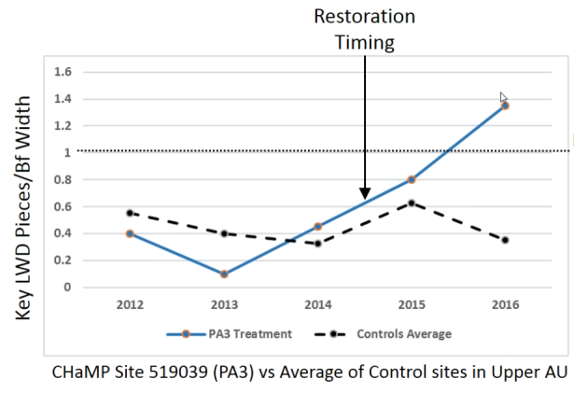
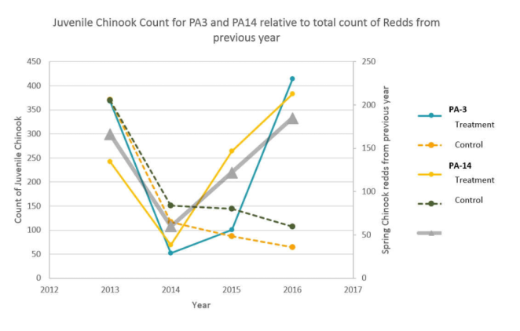
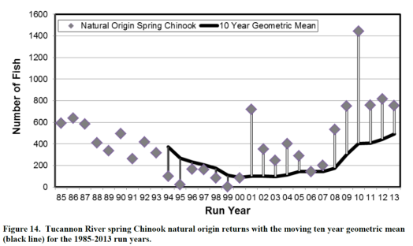

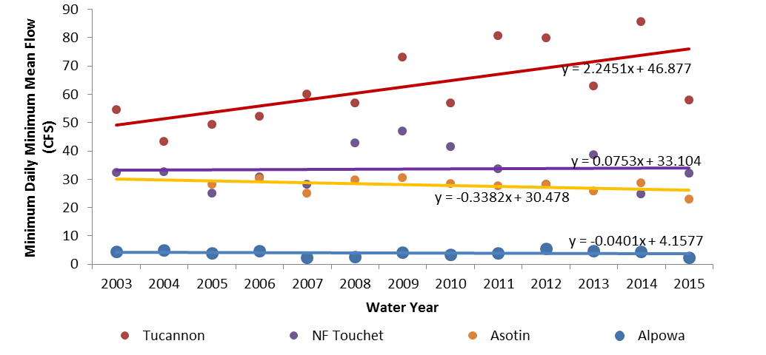
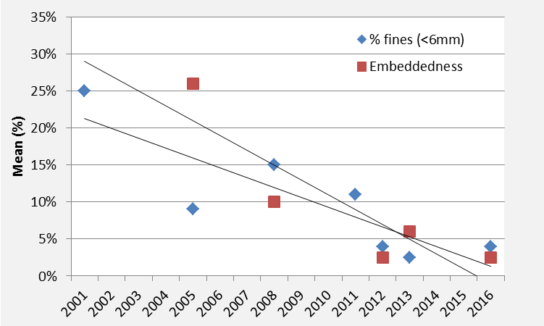
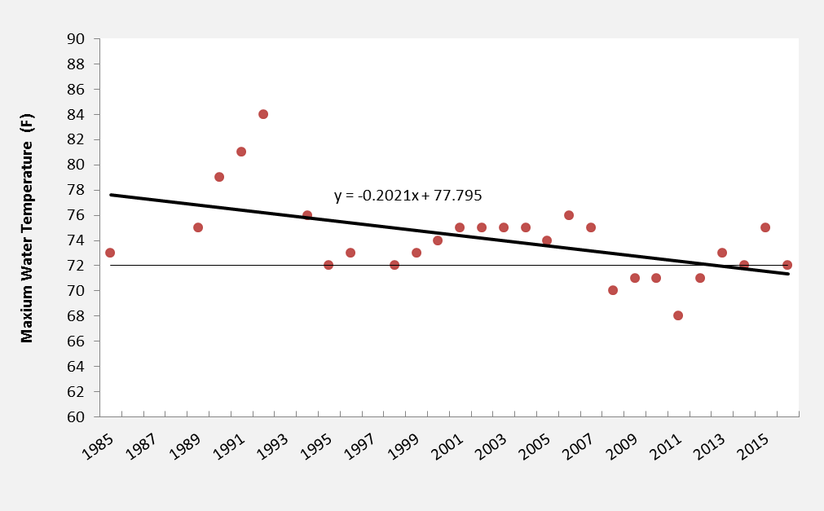
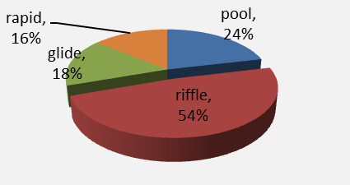
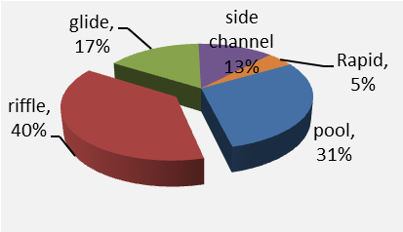
Results & Progress
Obj: >2 pieces
Fish Use of Treatment Sites
Fish Abundance
Goal >750 adults
Stream Flow
Sediment Fines
Stream Temperature
Obj: >77cfs
Obj: <20% fines
Obj: <4 days >72°F
20 Days
13 Days
Pre-treatment Habitat Units
Post-treatment Habitat Units
Notes:
I need to sort this one out but it mainly is a slide showing we are collecting data working towards our objectives is the message

Slide 18
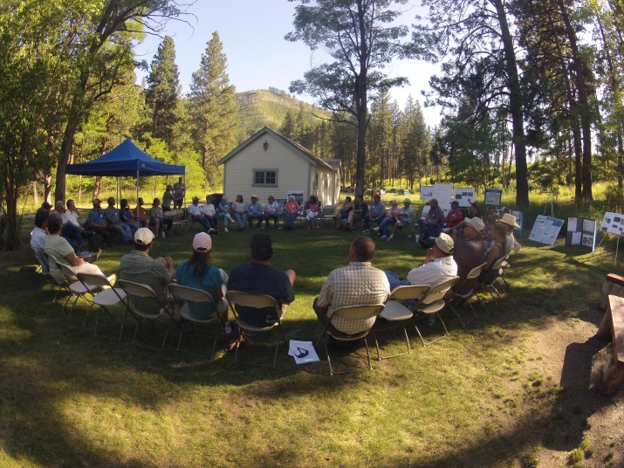
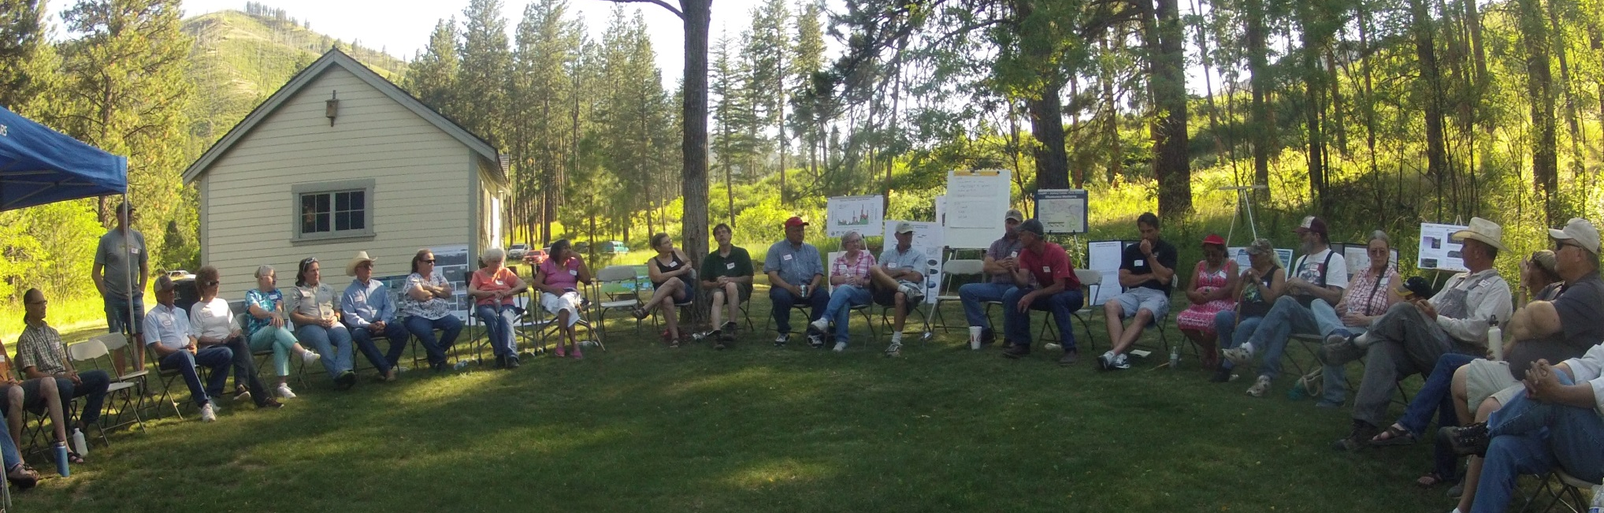
Summary
Science
Natural Process
Partnerships

Slide 19

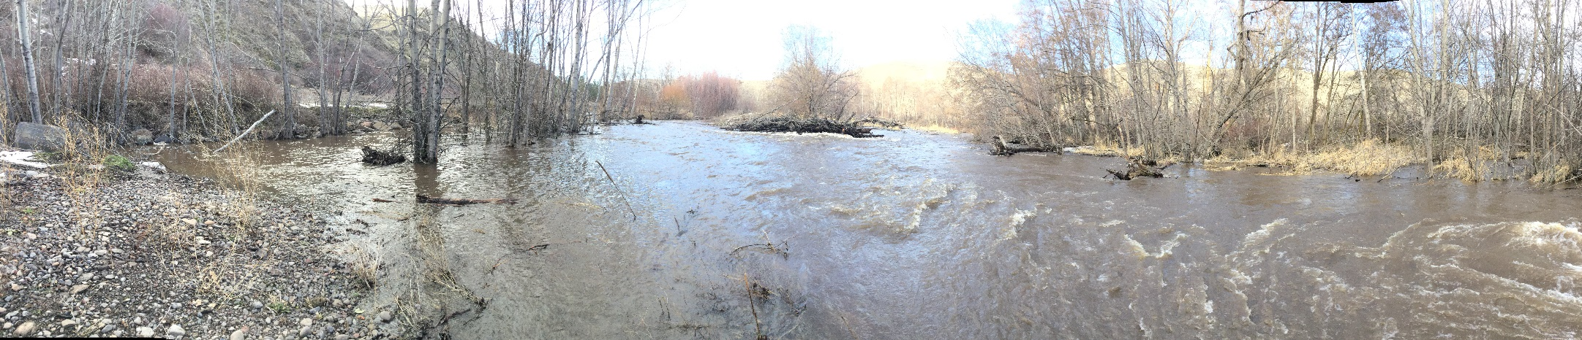
Special Thanks
Tucannon Landowners

Slide 20
Questions
Geomorphic Assessment*
Subbasin Plan
Salmon Recovery Plan
Conceptual Restoration Plan**
Design Funding
Implementation Funding
Project Sequencing (TCC & RTT)
60% Design
Implementers & Engineers 20% Conceptual
Review Process
Final Design
90% Design
SRSRB Review
Monitoring
Adaptive Management
Implementation
Monitoring
*Anchor QEA April 2011, ** Anchor QEA November 2011
Notes:
The Regional objectives Recovery Plan and Subbasin plan
Reviewed and updated in the Assessment collectively improving and updated the understanding of conditions
Restoration plan took the highest priority limiting factors and produced restoration actions for the highest priority river reach for spring chinook
Took the prioritize actions and developed conceptual projects
and then prioritized those restoration actions based on expected biological response, fit to geomorphic process and cost benefit.
Project solicitation was conducted differently in the basin where we are not sponsor limited and we knew the projects we wanted to fund.
We used the prioritized list and our TCC and RTT to match projects with implementers based on work load and expertise.
SRSRB helps in the public vetting process of conceptual design
TIC helps sponsors develop project designs with the RTT & TCC and sequence work to fit best with other projects and funding cycles and matching funds
Implementation is a collaborative effort as much as possible
Monitoring is mostly conducted by entities in which the program and the partners are involved and is used as a feed back loop to the public and the planning process.

Slide 21
Programmatic Funding 2011-17

Slide 22
Programmatic & Match FY11-16

